Slide 1
UberVideo DVD Rental Team K
James Wilson
Kritika Nautiyal
James Gormley

Slide 2
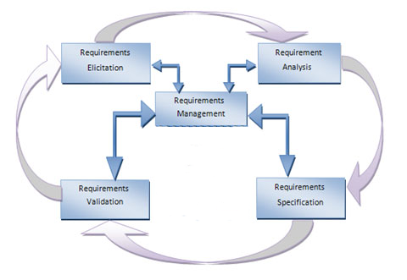
Requirements

Slide 3
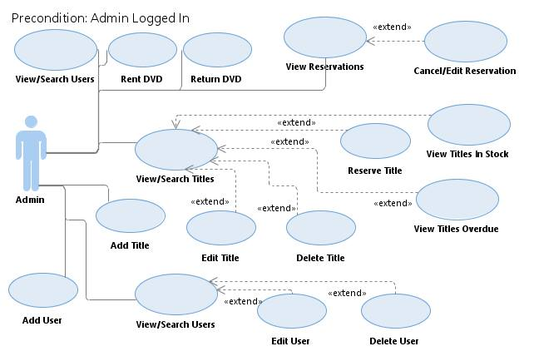
Design

Slide 4


Real Time Access.
Thick and Thin Clients.
Cross Platform Functionality.
More Cost Effective.

Slide 5
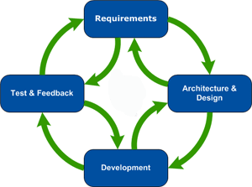
Development
Agile Methodology
Extreme Programming
Core Principles
Test Driven Development
Adaptive over Prescriptive
Whole Team
Pair Programming
Simple Design

Slide 6

Implementation
Success?
Core Functionality
End User Satisfaction
Requirements Implementation
Streamlining

Slide 7
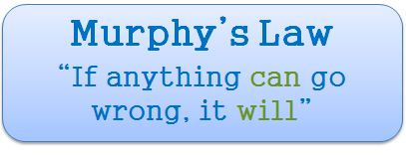
Issues

Slide 8

Addressing the Issues
Communication
Cooperation
Research
Trial & Error

Slide 9
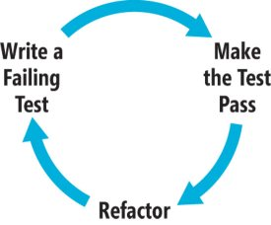

Testing
Why?
How?
When?

Slide 10

Conclusions
The Perks

Slide 11

The Downside
Who decides?
Even workload?
Who picks up the slack?

Slide 12

To Do It Again?
Planning
Requirements
Meetings
Workload
Other thoughts

Slide 13
So…
From
A Specification to Requirements, Planning & Design
Through
Development
Implementation
Testing
Deployment
To
The End, the Outcome & our Conclusions

Slide 14


Questions?
And

